Slide 1
Elements & Terminology
Aerospace Manufacturing Core Study Guide
“AMCSG-302”
Blueprints & Documents

Slide 2
Blueprint Elements

Slide 3
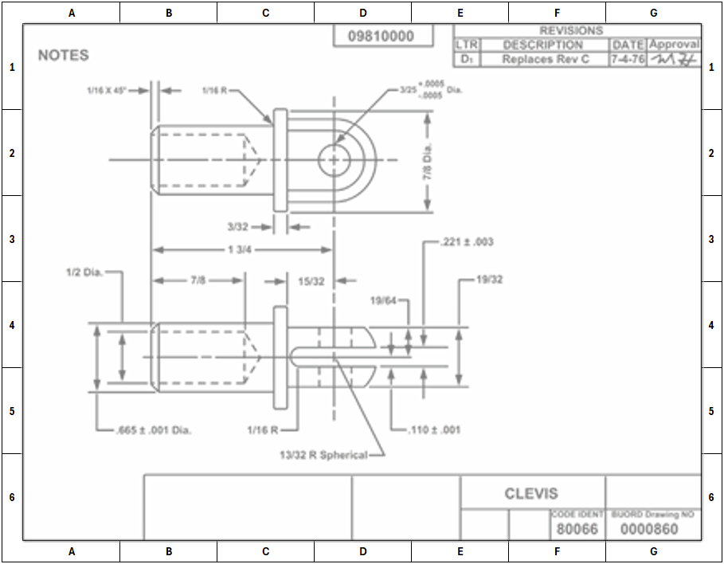
Border
Marks the boundaries of blueprint
Some blueprints have letters and numbers in the border for navigational aid to quickly locate items
(PD) U.S. Gov – NAVEDTRA14040A, 2015
Notes:
ChatGPT query identified USGovernment public domain document: https://media.defense.gov/2017/Nov/03/2002658619/-1/-1/1/171103-N-ZY182-15347.pdf

Slide 4
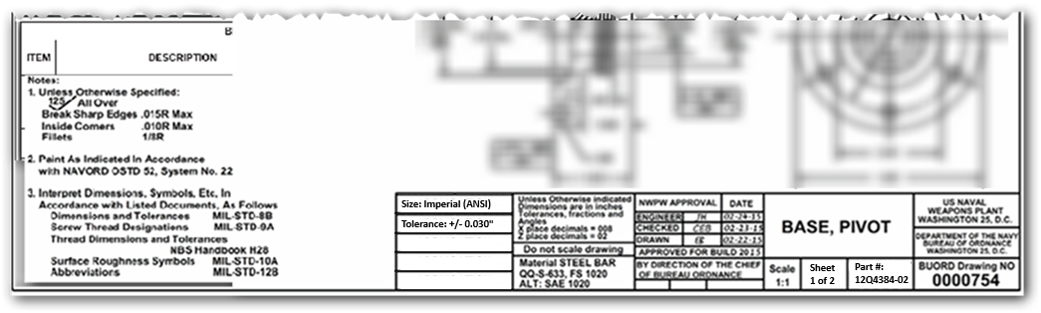
Title Block
Important information listed here
Notes
Drawing Title
Company
Size
Tolerance
Scale
John Doe
(PD) U.S. Gov – NAVEDTRA14040A, 2015
Signature
Material
Sheet #
Part #
Notes:
ChatGPT query identified USGovernment public domain document: https://media.defense.gov/2017/Nov/03/2002658619/-1/-1/1/171103-N-ZY182-15347.pdf
Modified a lot too by adding in missing elements

Slide 5
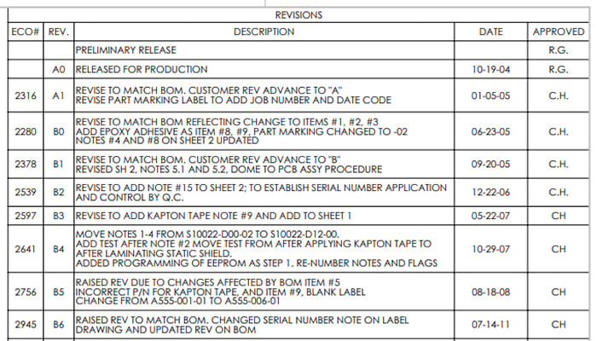
Revision Block
Change history list…
Revision #
What?
When?
Who?
(PD) U.S. Gov – NAVEDTRA14040A, 2015
Notes:
ChatGPT query identified USGovernment public domain document: https://media.defense.gov/2017/Nov/03/2002658619/-1/-1/1/171103-N-ZY182-15347.pdf

Slide 6
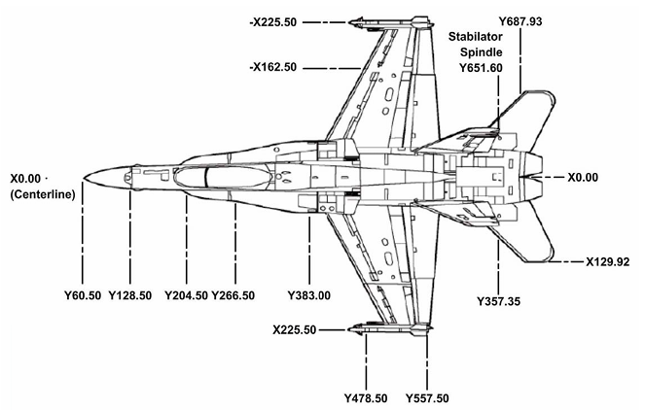
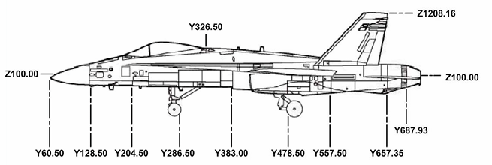
Picture Area
“The Object” - Where Detail, Assembly, or Installation diagrams reside
Lines, words, and symbols used
Top View
Right View
(PD) U.S. Gov – NAVEDTRA14040A, 2015
(PD) U.S. Gov – NAVEDTRA14040A, 2015
Notes:
ChatGPT query identified USGovernment public domain document: https://media.defense.gov/2017/Nov/03/2002658619/-1/-1/1/171103-N-ZY182-15347.pdf
YES, THE F18 IS PUBLIC DOMAIN, US GOVT DOCUMENT FROM LINK ABOVE ON PAGE 10 (1-5)

Slide 7
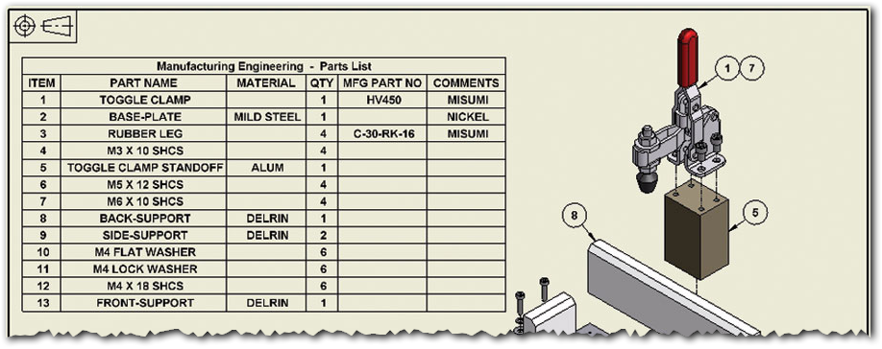
Parts List
Material
Part Number
Part Name
Qty Req’d
Finish
ChatGPT / Matt Pierce, 2026
Notes:
ChatGPT: Make a sample Parts List for an aerospace manufacturing blue print. Include: Part Number, Part Description, Quantity Required, Part Material Note, Part Finish Req. + make it a picture on a blueprint

Slide 8
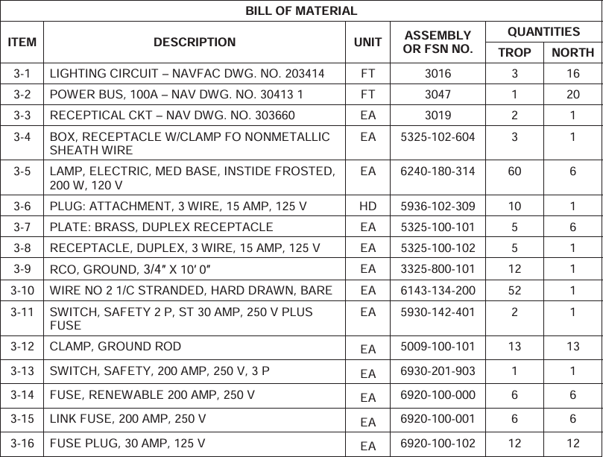
Bill of Materials
(PD) U.S. Gov – NAVEDTRA14040A, 2015
Notes:
ChatGPT query identified USGovernment public domain document: https://media.defense.gov/2017/Nov/03/2002658619/-1/-1/1/171103-N-ZY182-15347.pdf pg 11

Slide 9
Blueprint Terminology

Slide 10
Common Drawing Elements
.
Perpendicular:
Point:
Vertex
Straight Line:
Angle
Parallel:
Curved Line:
Acute Angle:
Chord:
Broken Line:
Right Angle:
Arc:
.
Concentric Circles:
Tangent:
Obtuse Angle:
Chamfer:
45°
Eccentric Circles:
Surface:
Matt Pierce, 2026
Notes:
ChatGPT: make a sample revision block from blueprint for aerospace manufacturing

Slide 11
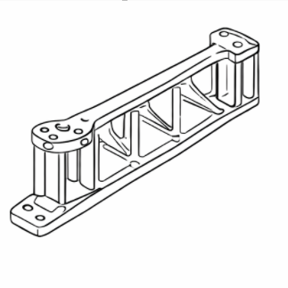
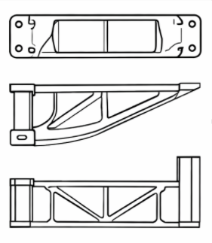
Types of Pictorial Drawings
There are three type of pictorial drawings…
Perspective:
Isometric:
Orthographic:
ChatGPT / Matt Pierce, 2026
ChatGPT / Matt Pierce, 2026
ChatGPT / Matt Pierce, 2026
Notes:
ChatGPT: Show the same aerospace manufacturing drawing in three different formats: 1. perspective drawing, 2. isometric drawing, and 3. orthographic drawing + make the perspective drawing (#1) more pronounced, make the perspective point closer in.

Slide 12
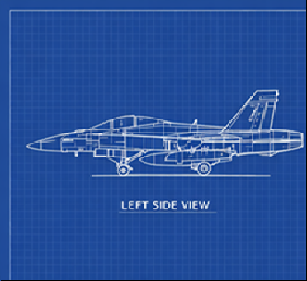
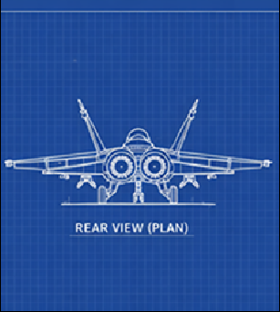
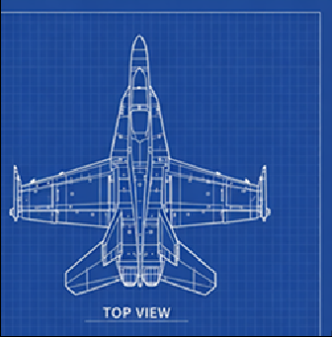
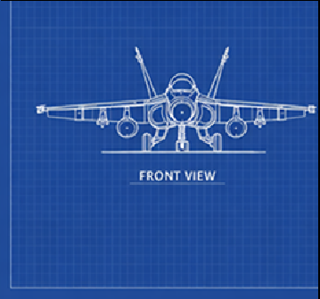
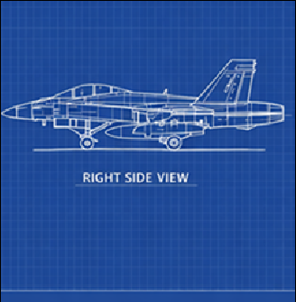
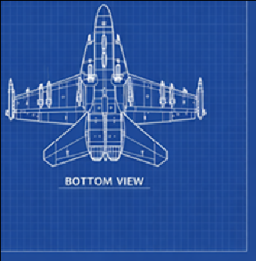
Orthographic Projection - Glass Box / 6 Face
ChatGPT / Matt Pierce, 2026
Right
Front
Bottom
Plan (Rear)
Top
Left
ChatGPT / Matt Pierce, 2026
Notes:
ChatGPT: make six blueprint diagrams showing me all angles of an F18 fight jet from us government public domain sources. left side, plan (rear), top, front, right side, bottom + make the left side view only into a photograph
+ remove the background. jet only.

Slide 13
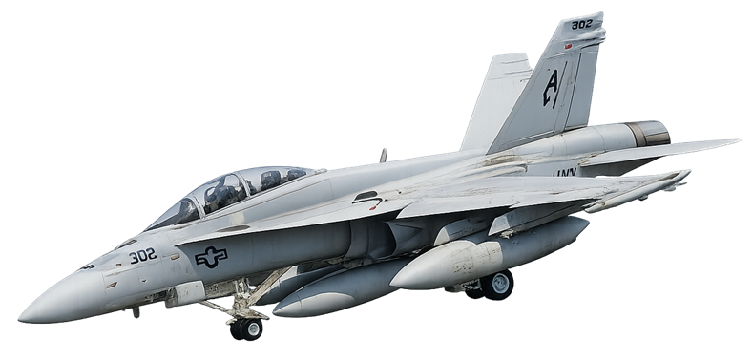
Aircraft Reference Planes (Axes)
STA | Longitudinal | Nose-to-Tail | Length | 0 = Before Front of Plane
BL | Lateral | Wingtip-to-Wingtip | Width | 0 = Center of Plane
WL | Vertical | Wheels-to-Tailtop | Height | 0 = Below Plane
Detail Drawings
Detail Drawings
Detail Drawings
0
0
BL – Buttock Line
STA - Station Line
ChatGPT / Matt Pierce, 2026
0
WL – Water Line
Notes:
Start with prior slide ChatGPT images, then add planes
ChatGPT: make six blueprint diagrams showing me all angles of an F18 fight jet from us government public domain sources. left side, plan (rear), top, front, right side, bottom + make the left side view only into a photograph + remove the background. jet only. + rotate this photo in a third dimension and then draw the STA (station line) axis, the WL (water line) axis, and BL (buttock line) axis. Make the axes in red line with long dashes and dots. + remove red axes + remove background

Slide 14
Q&A

Slide 15
Practice Q&A’s (Q1-Q8)
Q5: What columns are in the Parts List?
A: Part Number. Part Name. Quantity Received. Finish. Optionally: Material, Sequential Item Number.
Q6: What columns are in the Bill of Materials?
A: Item number. Description. Units. Assembly or FSN No. Quantity Ordered. Quantity Delivered.
Q7: How is a "Bill of Materials" different from a "Parts List"?
A1: Parts list is simpler static drawing based list of parts or assemblies on the sheet.
A2: BOM list is comprehensive dynamic list containing every part, material, sub-assembly, and instruction.
Q8: How many points are needed to define a straight line?
A: Two
Q1: Name for the edges of a blueprint, often broken down by letters and numbers for an easy lookup grid?
A: Border
Q2: Name two components of the Title Block beyond the Drawing Title and Sheet Number?
A: Company. Scale. Part Number. Notes. General Tolerances. Signature. Size. Material.
Q3: What columns are in the Revision Block?
A: Revision Number. Description. Date. Approved By.
Q4: What goes in the Picture Area?
A: Lines, words, and symbols to depict aircraft under construction

Slide 16
Practice Q&A’s (Q9-Q18)
Q14: Name of the point where two lines form an angle?
A: Vertex.
Q15: Name of two lines intersecting at 90°?
A: Perpendicular.
Q16: Name of an angle less than 90°?
A: Acute Angle
Q17: Name of an angle greater than 90°?
A: Obtuse Angle
Q18: Name of two different size circles both centered at the same point?
A: Concentric Circles
Q9: How many points are in a curved lined?
A: Infinite
Q10: Three points make a ___?
A: Surface (or plane)
Q11: Name of a line forming part of a circle?
A: Arc.
Q12: Name of the point where an arc touches a line?
A: Tangent
Q13: Name of two lines coming together at a point.
A: Angle

Slide 17
Practice Q&A’s (Q19-Q26)
Q23: Name of drawing type used in blueprints to show three different faces: Front, Top, and Right?
A: Orthographic.
Q24: Name of aircraft reference plane that is longitudunal, running nose-to-tail...the length?
A: Station Line (STA)
Q25: Name of aircraft reference plane that is laterial, running wingtip-to-wingtip...the width?
A: Buttock Line (BL).
Q26: Name of aircraft reference plane that is vertical, running wheels to tailtop...the height?
A: Water Line (WL) ... like a boat (from Boeing's shipbuilding start)
Q19: Name of two different size circles both centered at different points with the smaller inside the larger?
A: Eccentric Circles
Q20: Name of drawing view that is how the human eye perceives?
A: Perspective
Q21: What columns are in the Revision Block?
A: Revision Number. Description. Date. Approved By.
Q22: Name of drawing type that is similar to perspective, but has no vanishing point?
A: Isometric

Slide 18
Practice Q&A’s (Q1-Q8)
Q5: What columns are in the Parts List?
A: Part Number. Part Name. Quantity Received. Finish. Optionally: Material, Sequential Item Number.
Q6: What columns are in the Bill of Materials?
A: Item number. Description. Units. Assembly or FSN No. Quantity Ordered. Quantity Delivered.
Q7: How is a "Bill of Materials" different from a "Parts List"?
A1: Parts list is simpler static drawing based list of parts or assemblies on the sheet.
A2: BOM list is comprehensive dynamic list containing every part, material, sub-assembly, and instruction.
Q8: How many points are needed to define a straight line?
A: Two
Q1: Name for the edges of a blueprint, often broken down by letters and numbers for an easy lookup grid?
A: Border
Q2: Name two components of the Title Block beyond the Drawing Title and Sheet Number?
A: Company. Scale. Part Number. Notes. General Tolerances. Signature. Size. Material.
Q3: What columns are in the Revision Block?
A: Revision Number. Description. Date. Approved By.
Q4: What goes in the Picture Area?
A: Lines, words, and symbols to depict aircraft under construction

Slide 19
Thank You
Matt Pierce - mpierce710006@gmail.com - linkedin.com/in/mpiercead576/
https://github.com/DataResearchLabs/study_guide_intro_aerospace_mfg

